Slide 1
Upcoming Events
We have a lot of upcoming events. Please mark these on your calendar.
Fri. Feb. 25- Picture Retakes
Fri. March 11- ACC Midterm Advising
March 14-18- Spring Break
Fri. March 25- 11th/ 12th College Visit
Mon. April 4- ACC Summer Registration Opens
hi

Slide 2
Upcoming Events
Fri. April 8- International Fair
Fri. Apr. 15- No School
Mon. Apr. 18- No BISD, 11th/ 12th still have ACC
Fri. Apr. 25- Last Day to Withdraw from ACC classes
Fri. Apr. 29- 9th/ 10th College Visit
hi

Slide 3
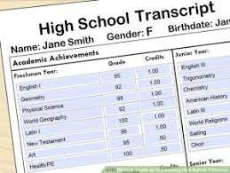
Transcript Information
Most of you should have received your transcript from Mr. Longoria.
Here is some information on how to read it.

Slide 4
Transcript Information
Your transcript lists all the classes you have taken since freshman year and your grades.
If you see letters beside the name of the class, look at the bottom of the page.
Some common ones:
D- College Dual Credit (ACC class)
R- Summer School
P- AP Course

Slide 5
GPA
In the bottom left hand corner is your GPA.
It is on the 100 scale. If you would like to convert it to a 4.0 GPA. Take the number divide by 20 subtract 1.
Ex. 100 GPA divided by 20=5
5-1=4.0 GPA
CRCA uses weighted GPA. That is why some of you may have over 100.

Slide 6
Class Rank
Your class rank will only be listed if you are in the top 10% of your class.
***Top 10 percent, not top 10 students.***
Why this matters:
The top student in the senior class receives free tuition for their first year of college.

Slide 7
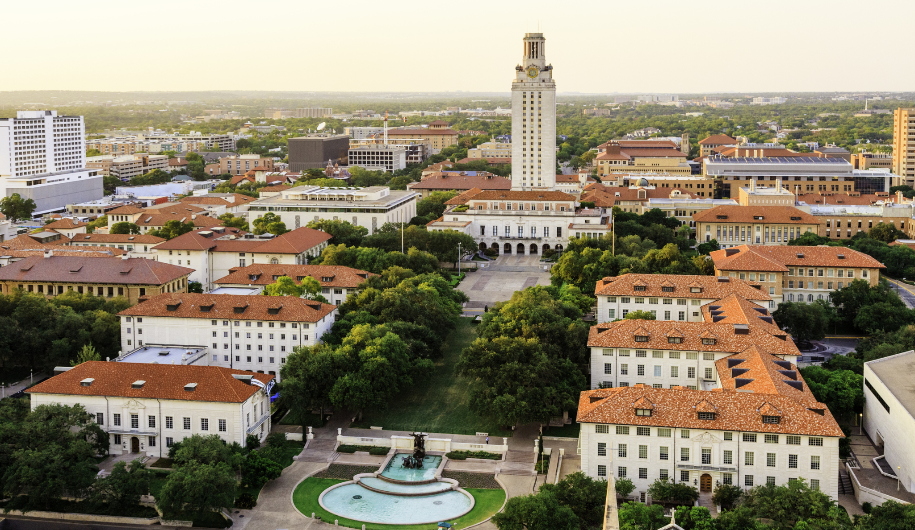
Class Rank
2. The top 10% receive automatic admission to any Texas public university other than UT.
For example A&M, Texas Tech, Texas State, UT Dallas
Only the top 6% receive automatic admission to UT Austin.

Slide 8
Next Week
Next week we will be covering how to register for summer classes and how to look at your ACC graduation overview to see if you are on track to graduate with your Associate degree.

Slide 9
College Prep Assignment
In the comments section, please answer the following question:
If you could have dinner with anyone, dead or alive, who would it be and why?

